Slide 1

Employee Attrition Analysis
April 2023

Slide 2
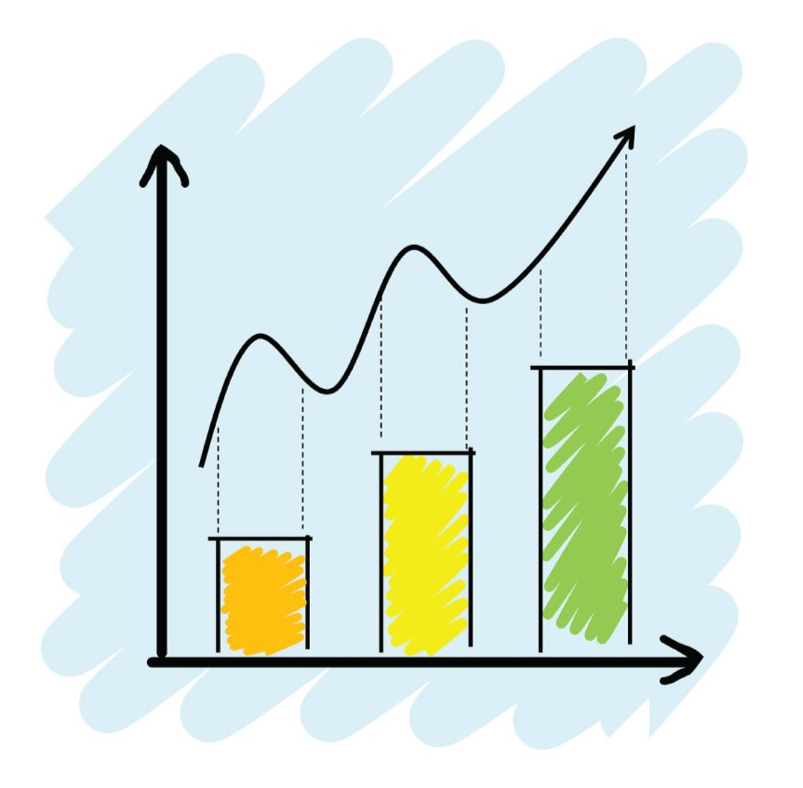
Agenda
Business Objective
Dataset Description
Data Analysis and Visualization
Research Questions
Conclusion & Recommendations

Slide 3

Business Objective
Attrition, in Human Resource terminology, refers to the phenomenon of the employees leaving the company.
Attrition in a company is usually measured with a metric called attrition rate.
To predict the attrition of the company’s valuable employees, uncover the factors that lead to employee attrition and explore important questions such as ‘show me a breakdown of distance from home by job role and attrition’ or ‘compare average monthly income by education and attrition’.

Slide 4
Dataset Description
The dataset has 1470 rows and 27 columns.
The features data types consist of 18 integers and 9 objects.
Total 25 objects can be categorize into categorical data and 2 into continuous data.
Total 231 null values was found from different object.
 | Age | Attrition | Business Travel | Department | Distance From Home | Education Field | Employee Number | Environment Satisfaction | Gender | Hourly Rate | Job Involvement | Job Role
Count | 1446 | 1470 | 1440 | 1466 | 1470 | 1458 | 1470 | 1470 | 1425 | 1470 | 1470 | 1460
Unique | nan | 2 | 3 | 3 | nan | 6 | nan | 4 | 2 | nan | 4 | 9
Mode / Mean | 36 | No | Travel Rarely | Research & Development | 2 | Life Sciences | nan | 3 | Male | 66 | 3 | Sales Executive
Null Value | 24 | 0 | 30 | 4 | nan | 12 | nan | nan | 45 | nan | nan | 10

Slide 5
 | Job Satisfaction | Marital Status | Monthly Income | Num Companies Worked | Over18 | Over Time | Performance Rating
Count | 1470 | 1414 | 1470 | 1470 | 1416 | 1470 | 1470
Unique | 4 | 3 | nan | 10 | 1 | 2 | 2
Mode/Mean | 4 | Married | 6502.93 | 1 | Y | No | 3
Null Value | 0 | 56 | 0 | 0 | 54 | 0 | 0
 | Relationship Satisfaction | Total Working Years | Training Times Last Year | Work Life Balance | Years At Company | Years Since Last Promotion | Years With Curr Manager
Count | 1470 | 1470 | 1470 | 1470 | 1470 | 1470 | 1470
Unique | 4 | nan | nan | 4 | nan | nan | nan
Mode/Mean | 3 | 10 | 2 | 3 | 5 | 0 | 2
Null Value | 0 | 0 | 0 | 0 | 0 | 0 | 0

Slide 6
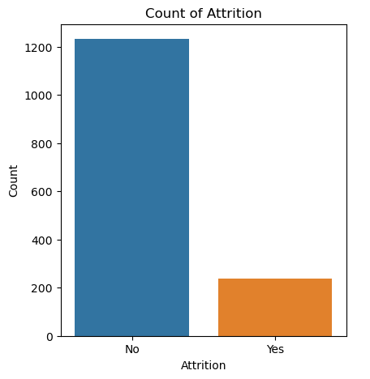
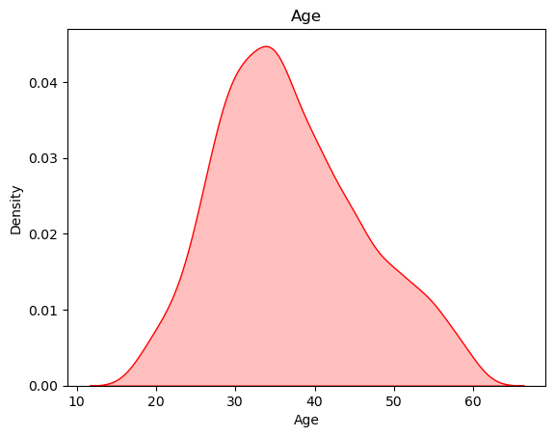
Data Analysis and Visualization
Univariate analysis
In the company, there are 1470 employees. 237 employees who compose 16% of the total number of employees left the company for some reasons. Besides that, 1233 employee is currently continuing to work in the same company.
Maximum number of employees working in the company are from age group 25 to 40.

Slide 7
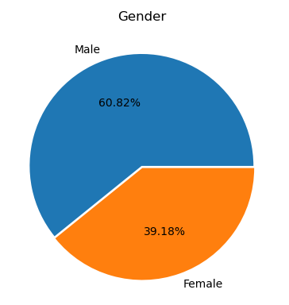
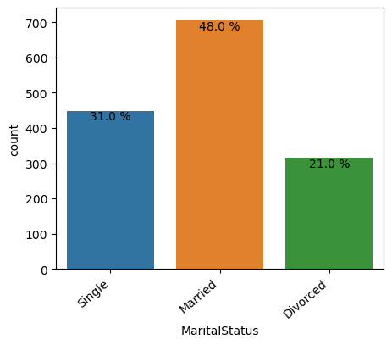
Male employees are more in number, contributing to 60.82%
Married employees are more in the company with 48.0% total contribution.

Slide 8
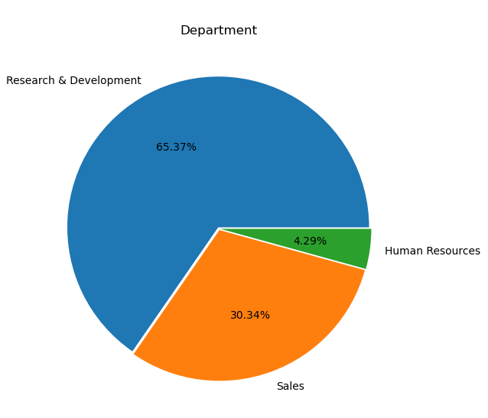
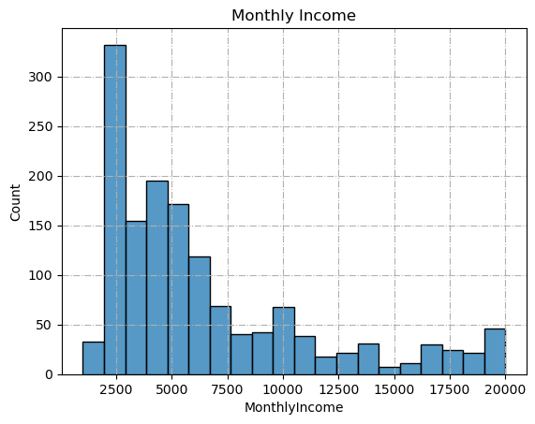
Three main departments, major employees are from Research & Development followed by Sales department and Human Resource.
The average salary in the company is 6502.93 dollars and maximum employees having salary range 2000 to 5000 dollars.

Slide 9
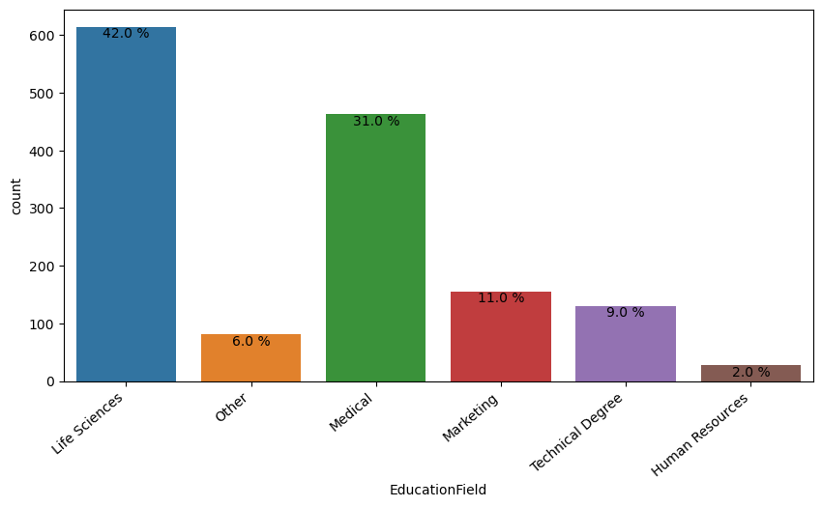
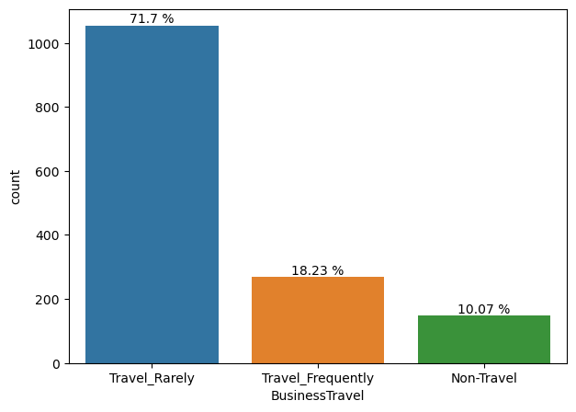
The dataset indicates that most of the employees belongs to life science field. which adds up to 42% of the total employees.
In the company, most of the employee travel rarely or don't travel. That group compose the 71.7% of entire company. The rest of the company employees which is 18.23% of them must travel frequently. and 10.07 % non-travel.

Slide 10
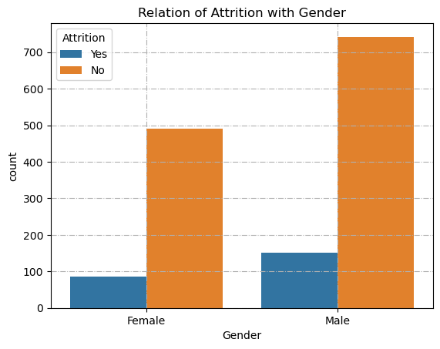
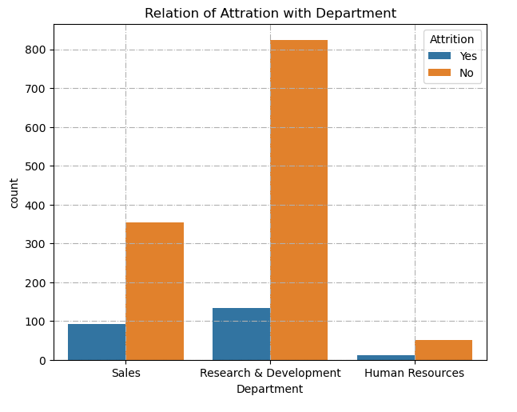
Bi-Variate Analysis
Male employees are more likely to leave the company than female employees.
Sales Department has mostly been affected by the attrition. Because 92 employees left the organization out of 446. This is the highest number compared to the other two departments. 12 employees left the organization out of 63 in human resource department and 133 from R&D department out of 961.

Slide 11
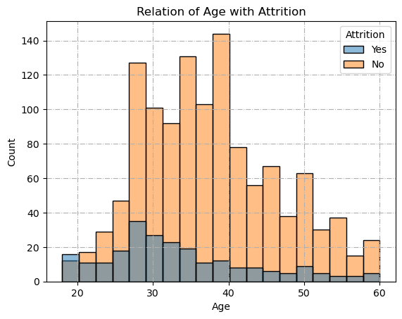
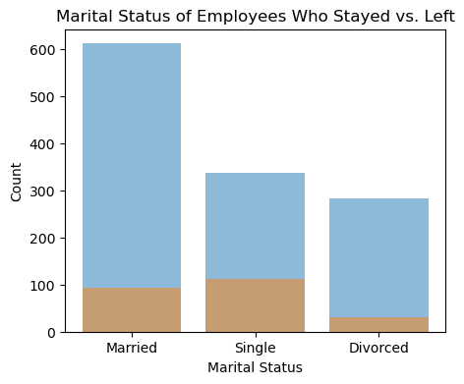
26-35 age group's attrition number is the highest comparing to other age groups That makes up approximately 49% of all attrition in the company.
Single employees are more likely to leave the company. They have the highest attrition number and compose of the 50.6% employees who left the company.

Slide 12
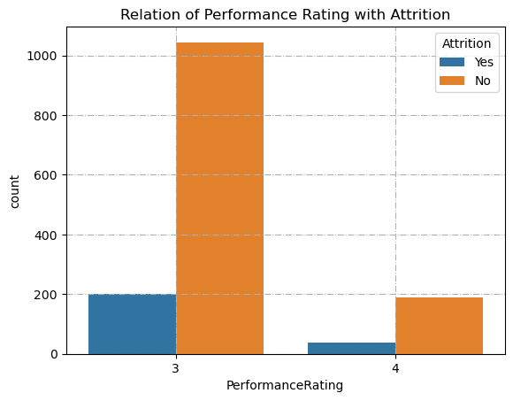
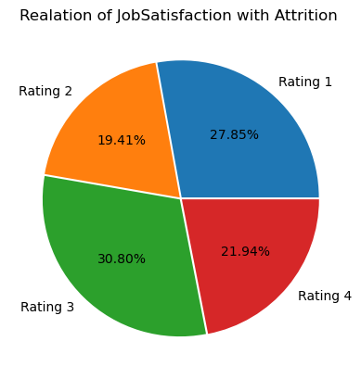
Performance rating 3 group has the highest attrition number and compose 84.4% of all attrition in the company.
In satisfaction rating 3 group, surprisingly employees leave the company most and their attrition composes 30.8% of company's attrition. As it may be expected, in job satisfaction rating 1 group, employees leave the company more than other groups except satisfaction rating 3 group. They compose 27.85% of all attrition in the company.

Slide 13
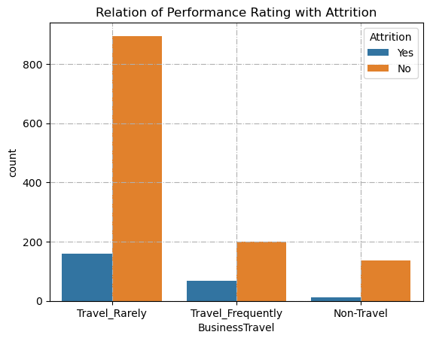
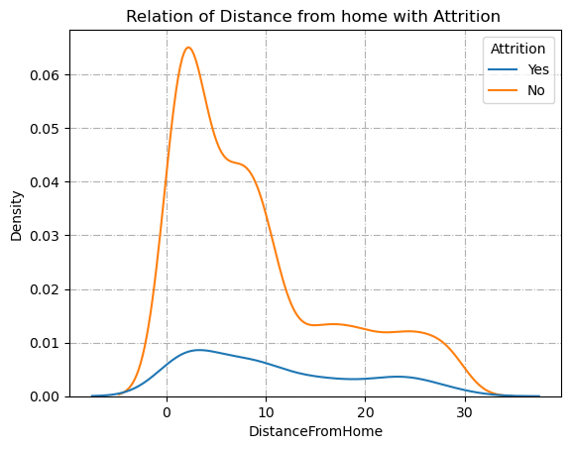
The highest attrition number belongs to the employees who travels rarely. That is approximately 15% of employees in that group. But when you put this number overall attrition, it makes up 65.8% of all attrition in the company.
If we look at the attrition percentage of relevant travel group, the employees who are traveling frequently are in the danger zone. Because they have the highest attrition proportion, which is 24.9%, in their individual travel group. That group's attrition rate composes of the 29.1% of overall attrition in the company .
Employees who don't travel in their current role have the lowest attrition rate, which is 8%.
There is a higher proportion of attrite employees who stay far from the office (More than 10 KM) than the proportion of employees who did not leave the company and stay far away from the office.

Slide 14
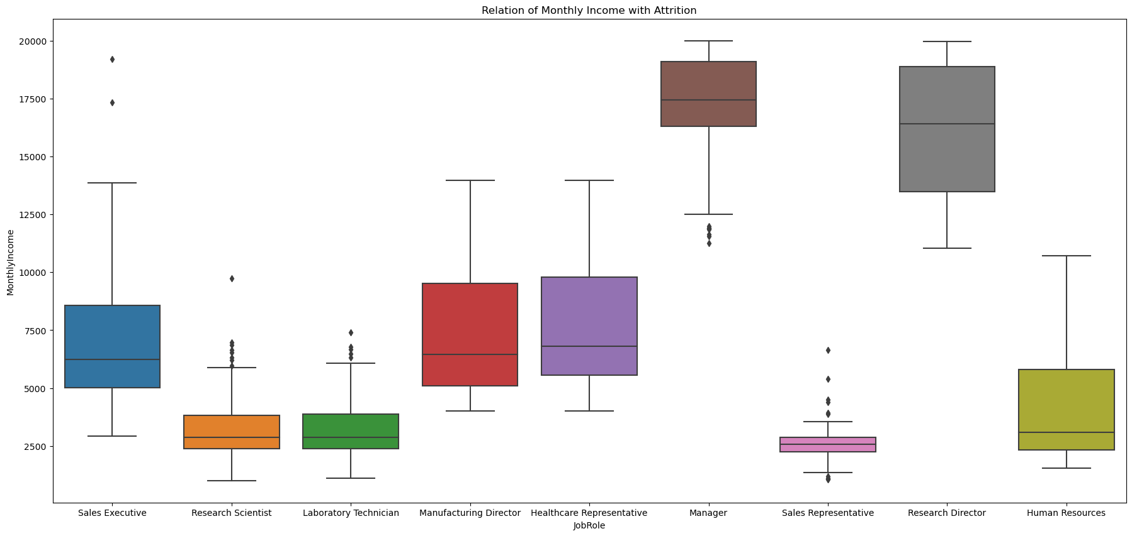
The median salaries of Managers and Research Director has to be obviously on the higher side.
The median salary of Sales Representatives, Laboratory Technicians and Human Resources Employees tends to be on the lower side. In the attrition rate vs job role graph, these groups comparatively had the highest attrition among the other roles.

Slide 15
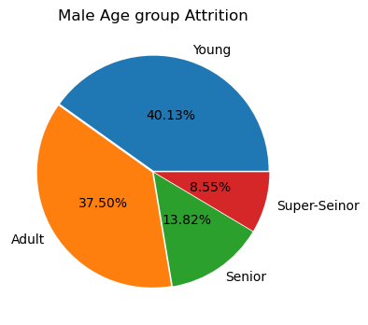
Research Questions
Which age group of men has a larger Attrition?
In 18-30 age group, young employees are more likely to leave the company. Their attrition proportion to their age group is approximately 40.13%
30-40 (Adult) age group's attrition number is the highest comparing to other age groups. In this age group, we have 37.50 % of employee attrition.
40-60 age group generally prefers to secure their job in the same company.

Slide 16
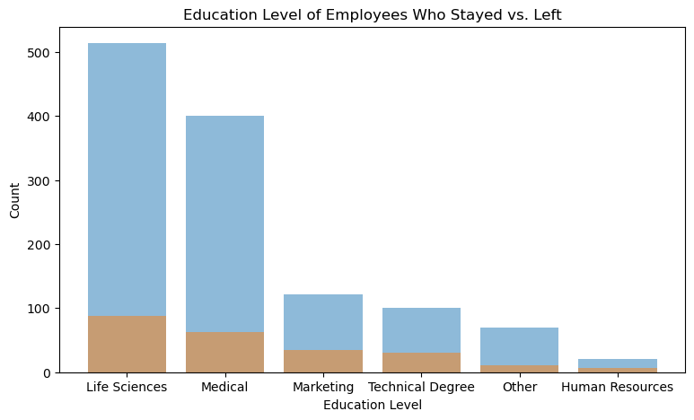
Which education field has a larger Attrition?
Employees who have Life Science education level have the most attrition number which makes up the 37.5% of all attrition.
Medical education level has the second highest attrition number which makes up the 13.57% of all attrition
Besides that, Human Resources, Technical Degree, and Marketing fields are mostly affected by the attrition respectively. Their approximately 22-26% employees left the company.

Slide 17
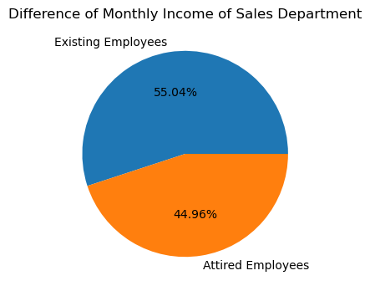
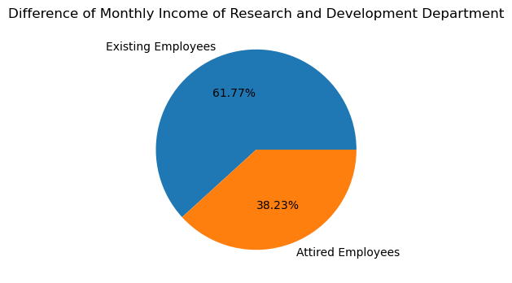
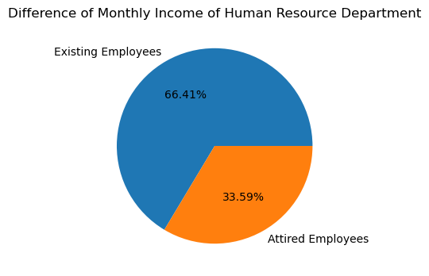
Does average monthly income of employees who left the organization are different from employees still with organization ?
Yes, the average salary of employees who are with the organization is higher than that of employees who leave the organization.

Slide 18
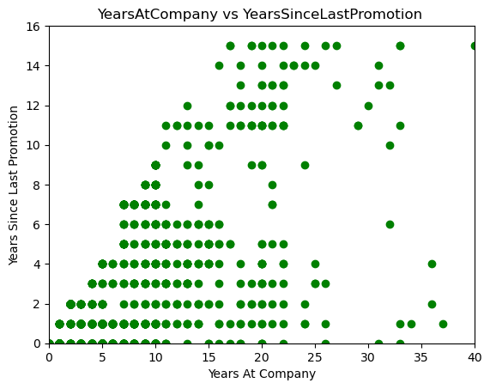
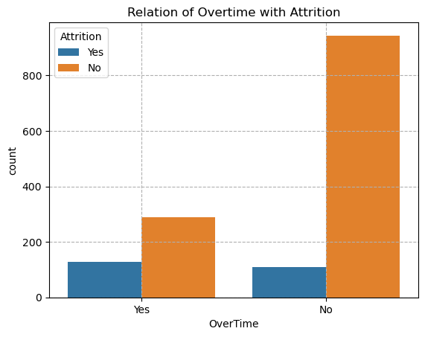
How does the over time and promotion effect the attrition?
The Promotion graph getting spaced out towards the right hand side, indicating a positive correlation between these two variables.
Here we note two things. Firstly, there is a relatively higher percentage of people working overtime in the group of those who left, secondly, while things seem to be going in the right direction for the group of people who continue with firm, the opposite is happening in the other group.

Slide 19
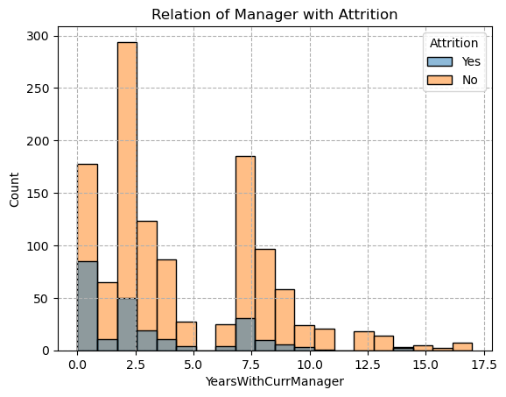
Does Manager plays any role in attrition rate ?
Most of the employee quit the company before completing their first year with their current manager. Other group who leaves the company most is the ones who work two years with current manager.

Slide 20
Conclusion and Recommendations
Males at higher attrition risk comparatively than females.
5.6% of employees works as Sales Representative and 17.6% of employees works as Laboratory Technician. These two-job roles should be questioned, and the company should find the reason(s) why these job roles face more attrition rate than all others and take necessary actions.
There are some other factor which effect the attrition rate. These factors are stated below.
Years in current role,
Environment satisfaction,
Job satisfaction,
Years with current manager,
The company should primarily try to increase the effectiveness of those factors. As a result, it will yield to the decrease in the attrition rate.
Long distance between employees home and company location. Company should make some accommodation arrangement.
32% of employees are single and has the highest attrition percentage(25.5%). The company should be aware of this important factor and have strategy to deal with this groups' performance.

Slide 21
18.23% of the employees travels frequently, and they have the highest attrition percentage(25%). The company should question what makes traveling a burden on their employees. The company should balance the travel status and if necessary, there might be some adjustments on the job description in terms of traveling. The company may use some extra incentives to motivate their employees who are supposed to travel.
Low monthly income is one of the cause for attrition rate. According to the performance of the employees the company has to give salary hike on time.
28.3% of employees have over time work in the company and 30.5% of those employees leave the company. As it is also reflected in the model, employees working overtime are significantly more likely to resign. Therefore, the company should understand the reason why they are working overtime.

Slide 22
Thank You

